Slide 1

Image and Video Compression Lab
Ivan Nikolovski

Slide 2
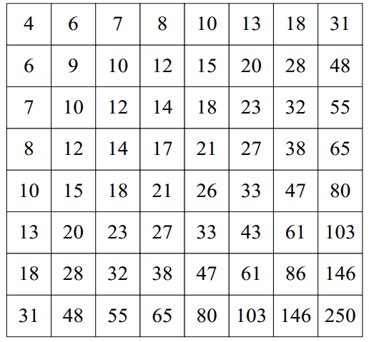
DPCM
Divided the DCT Transform into AC and DC coefficients
Encoded the 63 AC components of each block using zero run
Encoded the DC component of each block using DPCM
Example DPCM: 150, 155, 149, 152, 144 → 150, 5, -6, 3, -8
This reduced the bit rate very significantly since the differences between DC components was small and thus required less Huffman codes
Adaptive quantization table
Instead of the default luminance table I used the adaptive quantization table → slight PSNR increase
Fu, Qiming, et al. "A novel deblocking quantization table for luminance component in baseline JPEG." J Comm 10.8 (2015): 629-637.

Slide 3
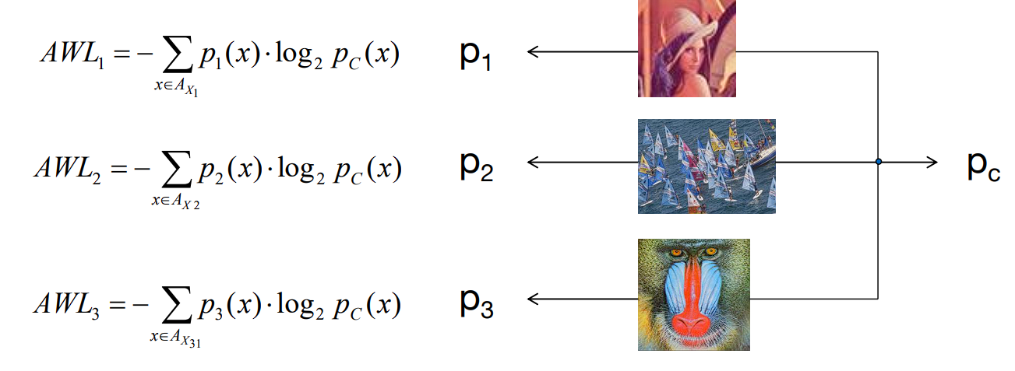
Common Huffman Tables
Using all 5 provided video sequences
Calculated the PMFs of each image and created a common code table for both the AC and DC components → bit rate reduced
Calculated the PMFs for the motion vectors and zero run encoded residual image → insignificant bit rate reduction
Computation time was significantly reduced since it wasn‘t necessary to calculate the Huffman tables, rather just load the precomputed Huffman table for each scale

Slide 4
Motion Vector Estimation
Sum of squared differences PSNR: 40.4282dB Time/Image:0.196s
Three step search PSNR:38.3831dB Time/Image:0.053s
2D Logorithmic Search PSNR:39.2699dB Time/Image: 0.079s
Deblocking filter
For the scales with lower quality I used a deblocking filter
This resulted in a significant increase in PSNR
The deblocking filter used was the medfilt2 filter in MATLAB

Slide 5
